Slide 1
CAPSTONE PROJECT – CSE4099 Stock Analysis and Prediction using scraped news articles on a Deep Learning architecture Review 2
By – Ronet Swaminathan
Reg. No.- 16BCE1166
Project Guide – Prof. Sridhar R.

Slide 2
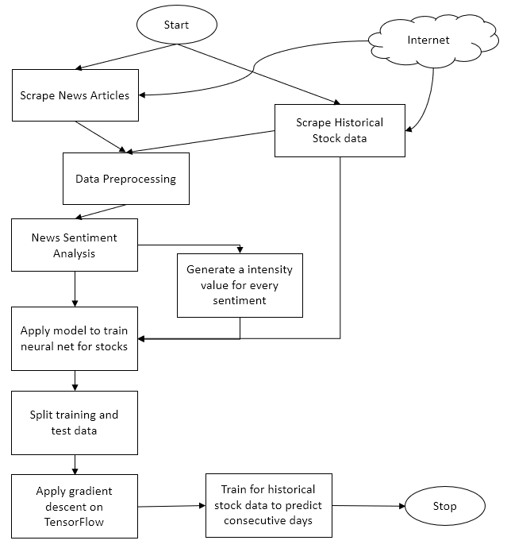
Engineering Design
A flowchart that simplifies the architecture of the project.

Slide 3
Technical Implementation steps taken (Till Review 1)
Literature surveys done to know the state of existing works in the field.
Historical stock data has been scraped from websites like Quandl and Yahoo Finance. The stocks are dated from 2012 to 2018 (i.e. 5 years of stock data)
Analytics has been done on the extracted stock data. Several statistics like risk and return trends, moving average and correlation measures have been deduced.
Following are some of the graphs and related code that has been implemented.

Slide 4
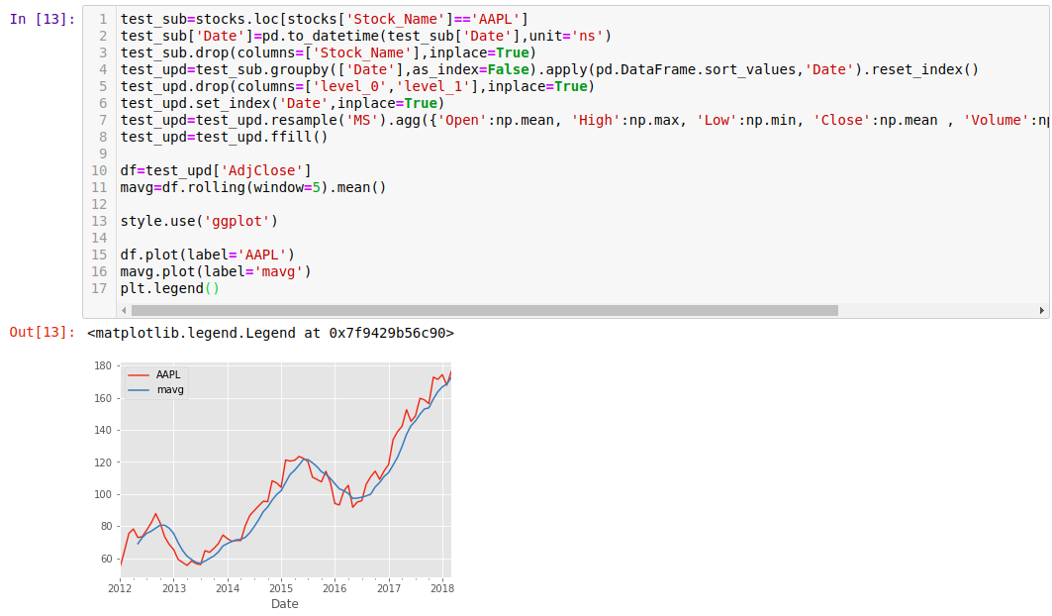
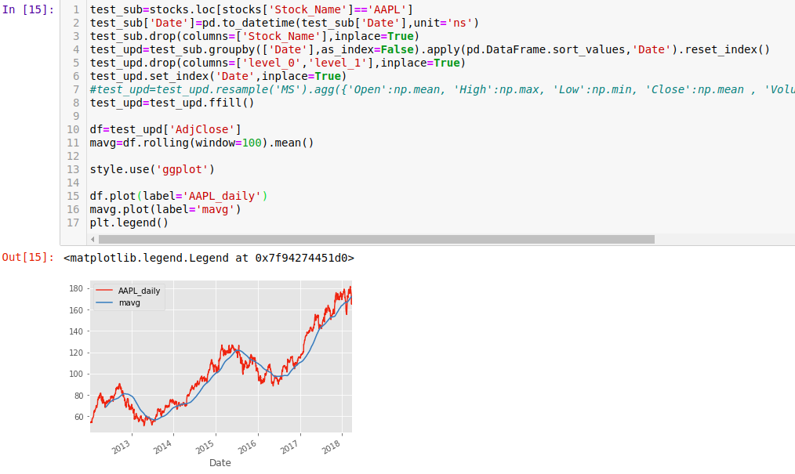
Apple Stock trend – resampled by month and through moving average with rolling window = 5
Apple Stock trend – preprocessed raw from scraped data and its moving average with rolling window = 100

Slide 5
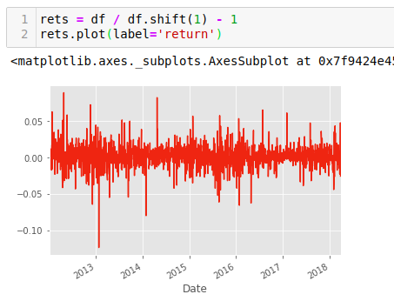
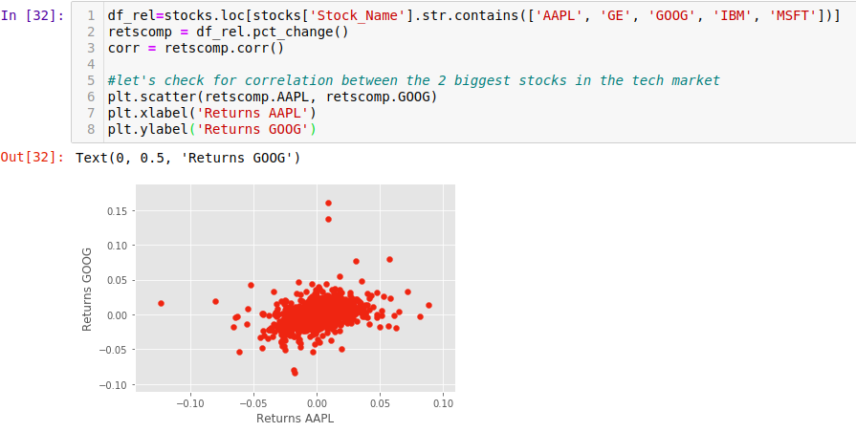
Apple Stock trend – returns graphed for the scraped time period by standardized formula
Correlation between Apple and Google stock

Slide 6
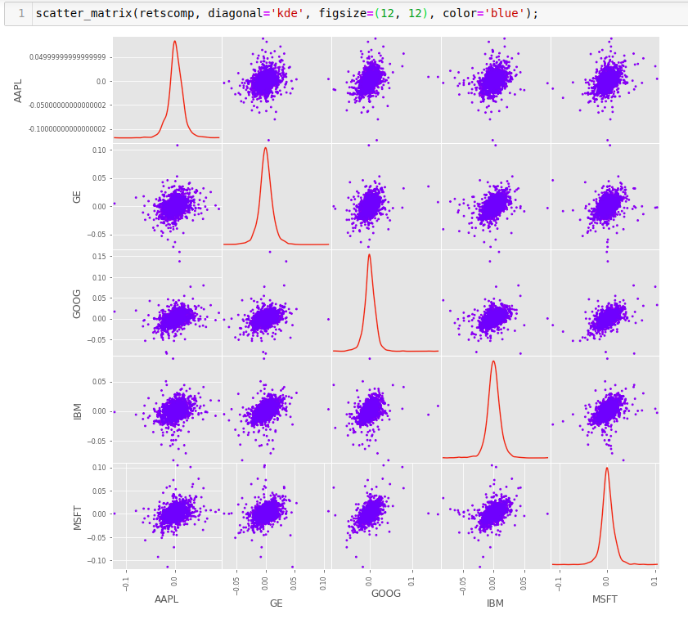
Correlation Scatter Matrix between the dominant stocks

Slide 7
Text News Extraction
Collected data from Reuters and NASDAQ, 2 very popular websites producing finance and stock news.
Used BeautifulSoup to scrape the web pages and stored them into csv files.
Files named “date” wise, containing all the news published that day by the news sources.
Each file will have atleast 1 news of 1 stock ticker.
Not necessary that each each will have some news on a daily basis

Slide 8
Data Preprocessing
Longest part of the entire project timeline. Still under revisions.
Rescaled numerical stock data to smaller dimensions, removing all redundant columns thus, leading to dimension reduction from 14 to 8.
Final stock data used for analytics contains the following columns : [Date, Symbol, High, Low, Open, Close, Volume and AdjClose]
Cleaned text news off random ads by filtering out unnecessary keys in JSON.

Slide 9
Data Preprocessing (contd.)
After curating legible news articles, we then move onto processing that news.
For this, we will use sentiment analysis to calculate a normalized score and a magnitude score.
Derived a formula for sentiment magnitude, along with a scaling factor. Preprocessed data for various alphas.
As discussed back in review 1, this will help in measuring each news articles to determine “what type” of sentiment and “how much” of that sentiment.
This ultimately will help us calculate our loss function for the deep neural network.

Slide 10
Data Preprocessing (contd.)
Upon calculation of all the necessary features, we will then need to assimilate everything into a single dataset.
Thus, I took all the [ticker symbols, date, open, close] features into a separate dataframe and appended it with the features extracted from sentiment analysis.
To preserve the order of date, we took a datetime.timetuple() and extracted the day number of the year using the tm_yday parameter.
Therefore, the final processed dataset before training is of the shape (21286,6)

Slide 11
Machine Learning Models
Baseline testing – Though our aim is to set this project on a deep learning model, we created some machine learning regression models to get a baseline measurements.
This will help us to fine tune our DNN to achieve realistic and great RMSE (metric used here) values.
As DNN work on a somewhat different principle, we will be focusing on loss and cost function minimization.

Slide 12
Machine Learning Models (contd.)
For the purpose of setting a benchmark, 4 regression models were used.
They are : Linear Regression, Support Vector Regression, Random Forest Regression and Gradient Boost Regression.
Here are the results of a single run, with train test split in the ratio 70 : 30. The models were tested on 2 types of pre processed datasets, one that was simply label encoded and the other that was one hot encoded to take into account the stock tickers as well.

Slide 13
Performance Analysis
As we can see, there is a trend that says one hot encoded data usually gives better accuracy.

Slide 14
Other work done
Worked on the draft of the research paper, to be submitted in a respectable SCOPUS rated journal.
Started developing the neural network code, needs fault testing.
Extensive comparison and experimentation for paper.
Completing draft of the project thesis.

Slide 15
THANK YOU

